Slide 1

Marketing Campaign
Dimas Baswara Pramudita

Slide 2
Agenda
01
02
03
04
Introduction
Data Process
About me, Business overview
Extract data to forecasting with machine learning
Business Insight
Recommendations
Based on exploratory data analysis
Based on data providing business advice

Slide 3

01
Introduction

Slide 4

About Me
Data Science Enthusiast @dibimbing and @BinarAcademy | Business Intelligence @dibimbing | Python, SQL, EDA, ETL, Data Governance/Warehouse, Machine Learning, Data Visualization

Slide 5
Formal Education
Politeknik Penerbangan
Indonesia Curug
Universitas
Bina Nusantara
(2017-2020)
Manajemen Penerbangan
(2021-2023)
Manajemen Bisnis

Slide 6
Non-formal Education
Binar Academy
Dibimbing.id
Dibimbing.id
2022
Data Science
2022-2023
Data Science
2023
Business Intelligence

Slide 7
Introduction
The data is related with direct marketing campaigns of a Portuguese banking institution. The marketing campaigns were based on phone calls. In order to access if the product (bank term deposit) would be ('yes') or not ('no') subscribed.

Slide 8
What’s Bank?
Banks are intermediaries between depositors (who lend money to the bank) and borrowers (to whom the bank lends money). Their Primary roles:
Take the fund
Lend the fund
They make a profit from there.
Source : klik this link

Slide 9


These funds are then used by the bank to provide loans to individuals, businesses, or other institutions in need of financing. The difference between the interest rates received from borrowers and paid to customers generates an interest margin, which is one of the main sources of income for the bank.
They need “Money”
To get “Money”(Profit)
The bank collects funds from customers through various types of deposits such as savings accounts, checking accounts, and fixed-term deposits.

Slide 10

So…?
High Deposit
=
High Profit

Slide 11
Objectives
Opportunity
Efficiency
Profitability
The opportunity to attract as many customers as possible for deposits.
Minimizing time and costs to attract customers.
Increasing Profit.

Slide 12
02
Data Process

Slide 13
Data Process
Import Data &
Data Understanding
Exploratory Data Analysis
Modelling
01
02
03
04
05
Data Cleaning
Data Preprocessing

Slide 14
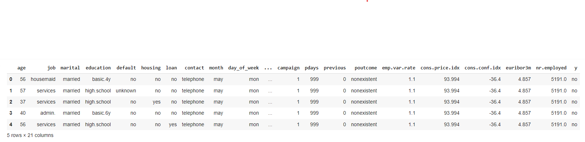
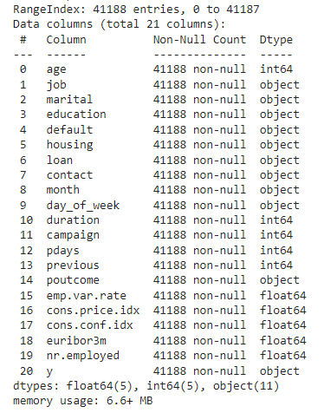
Import Data & Data Understanding
The ‘month' column's data type is 'object’, it will be fixed later during the data cleaning process.

Slide 15
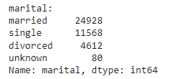
Import Data & Data Understanding
Example:
There are some “unknown" values which are actually missing values for us in variables:
Job
Marital
Education
Default
Housing
Loan
So, we will remove “unknown” value later during the data cleaning process.

Slide 16
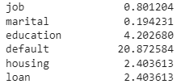

Data Cleaning
Missing Data
Duplicated Data
Handling Values
Data Type
They will be removed, except for the 'default’ there are 20% but default feature is mostly "no" which is highly imbalanced, I also drop this feature.
Remove it
At “pdays” there are 999 means client was not previously contacted). which means the value should be replaced with 0.
The values are march – December. Replace it with number 3 – 12.

Slide 17
Exploratory Data Analysis(EDA)
Descriptive analysis
Univariate
Analysis
Bivariate
Analysis
1
2
3
Correlation
Deep dive EDA
4
5
But this will be discussed further in the next section!!

Slide 18
Data Preprocessing
Feature Encoding
Min-Max Scaling
Train Test Split
Feature encoding is the process of converting categorical variables into numerical form so that they can be used by machine learning algorithms.
Min-Max Scaling is a method of normalizing numerical data within a specific range, typically between 0 and 1.
The process divides a dataset into two subsets: one for training a machine learning model and the other for testing its performance.

Slide 19
Modelling
Logistic
Regression
Random Forest
Classifier
Support Vector Machine
01
02
03
04
05
Decision Tree
Classifier
XGBoost

Slide 20
Various way machine learning models
Imbalance
SMOTE
Hyperparameter
Tuning
Performing machine learning modeling using imbalanced data.
Performing machine learning modeling using SMOTE.
The best machine learning model will be tuned and compared with the baseline model.

Slide 21
Modelling with Imbalance data

Slide 22
Modelling with SMOTE

Slide 23
Modelling with Hyperparameter Tuning
The best model is the Random Forest Classifier, whether it's the baseline model or the tuned one, both achieve a score of
93%

Slide 24
03
Business Insight

Slide 25
Exploratory Data Analysis(EDA)
Descriptive analysis
Univariate
Analysis
Bivariate
Analysis
1
2
3
Correlation
Deep dive EDA
4
5

Slide 26
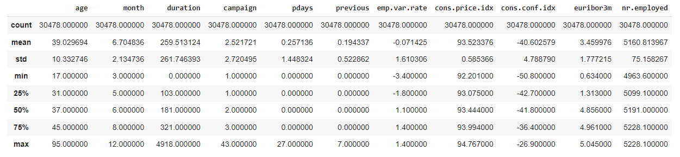
Descriptive Analysis
Based on :
Min & Max
Mean & Median
It can be observed that the distribution of the variable still makes sense.

Slide 27
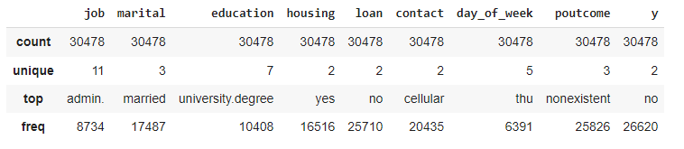
Descriptive Analysis
Based on that, you can see the count, unique values, top/mode, and frequency of that mode for each variable.

Slide 28
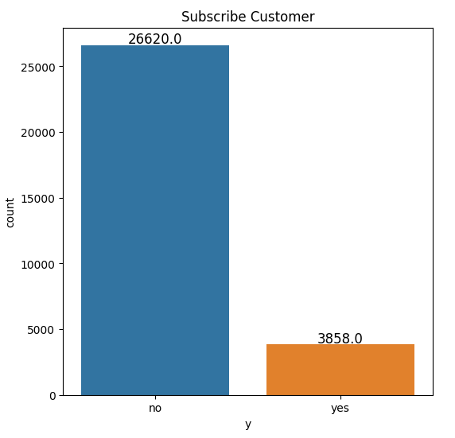
Univariate Analysis
It can be seen that the data is highly imbalanced, with only around 12,6% of customers joining.

Slide 29
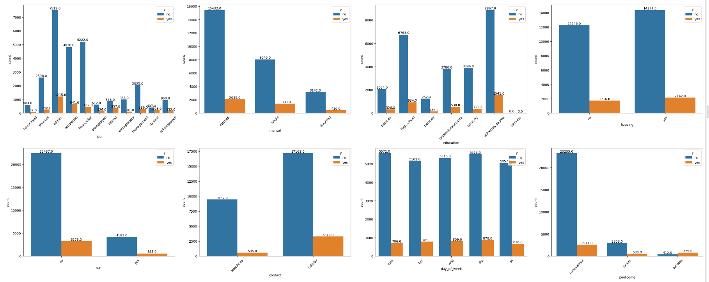
Bivariate Analysis : Bar Plot
Based on the bar plot, there is a difference in the number of categories within a variable, whether they differ significantly or evenly.

Slide 30
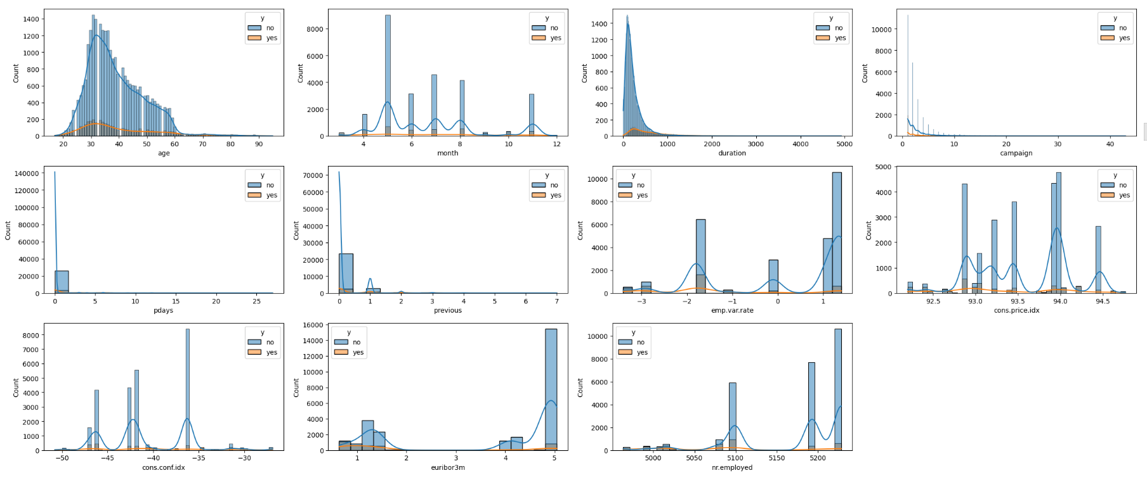
Bivariate Analysis : Histogram
Based on the histogram, the distribution of each variable can be observed.

Slide 31
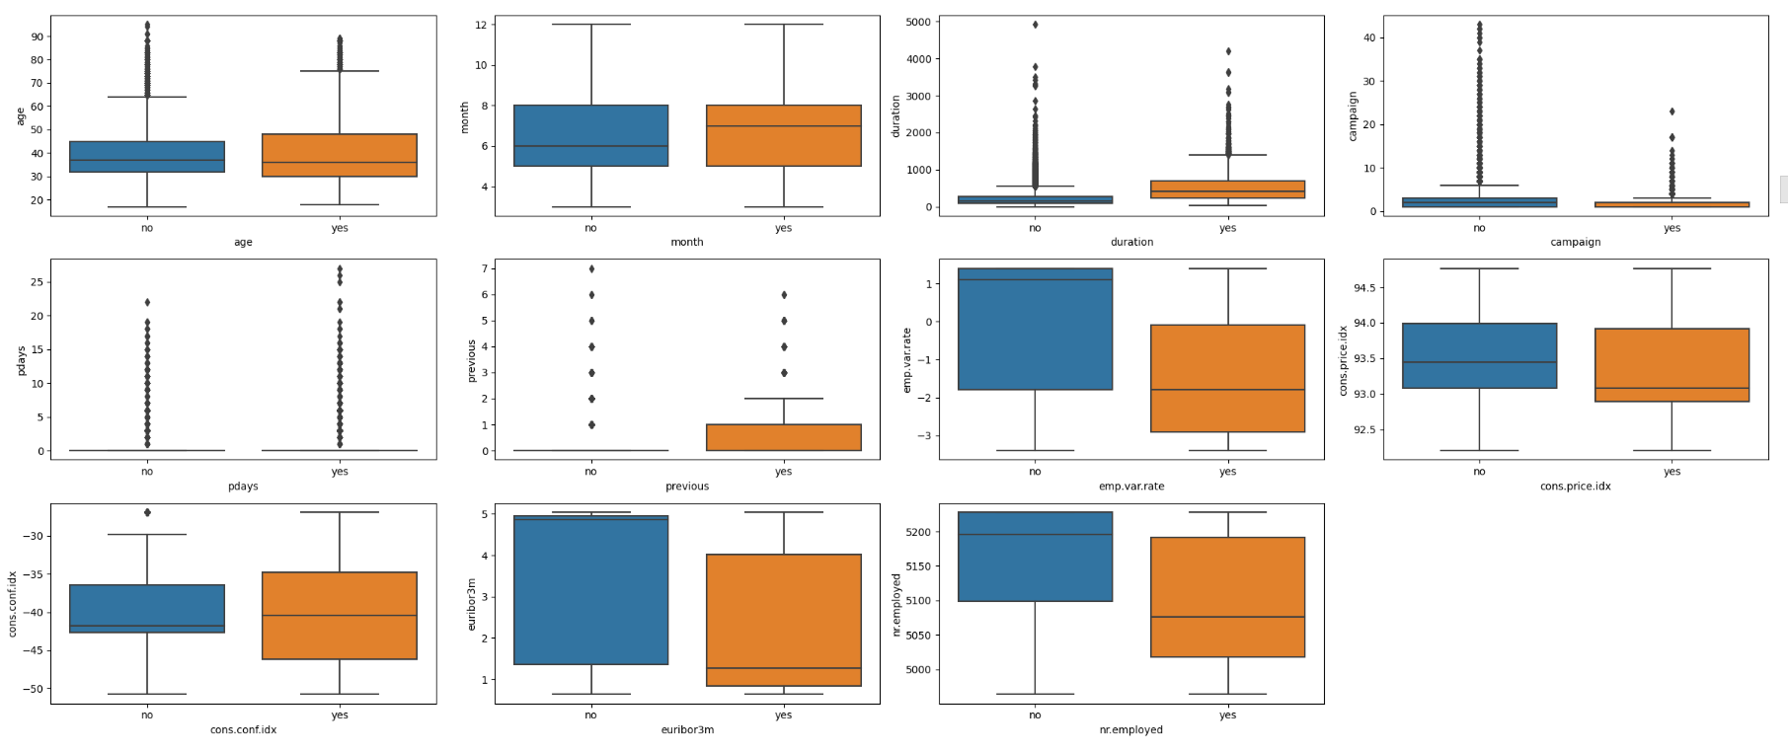
Bivariate Analysis : Boxplot
Based on the boxplot, there are outliers in several variables, and it enables a comparison of the median between 'yes' and 'no' for each variable.

Slide 32
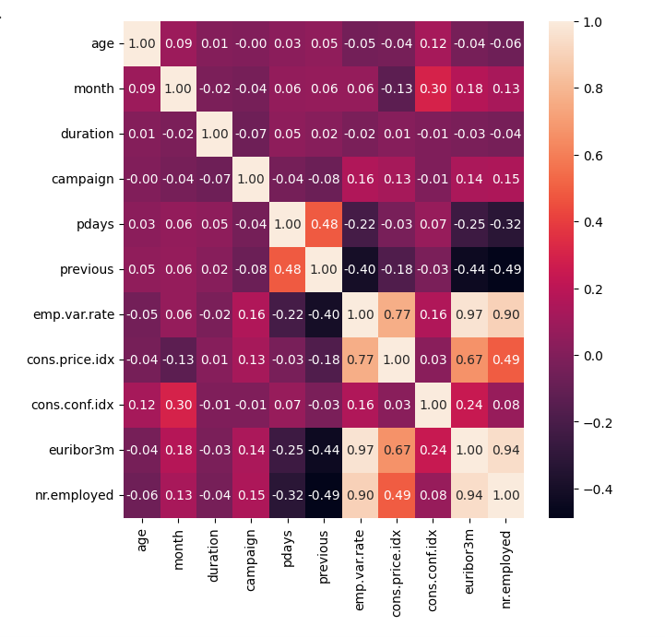
Correlation
Since these 3 variables have a high correlation value (> 0.8), 2 of them will be removed. Retain the “nr. Employed” variable

Slide 33
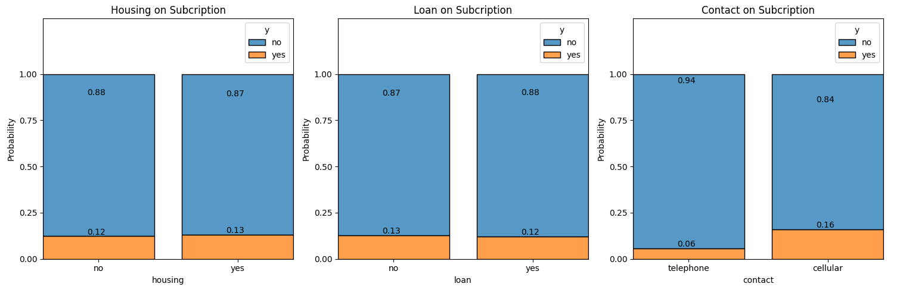
Deep Dive EDA Housing, Loan, & Contact on Subcription : Contact has the potential
It is found that contact via mobile celluller has an impact on subscription. And others do not have an impact for prospective customer.

Slide 34
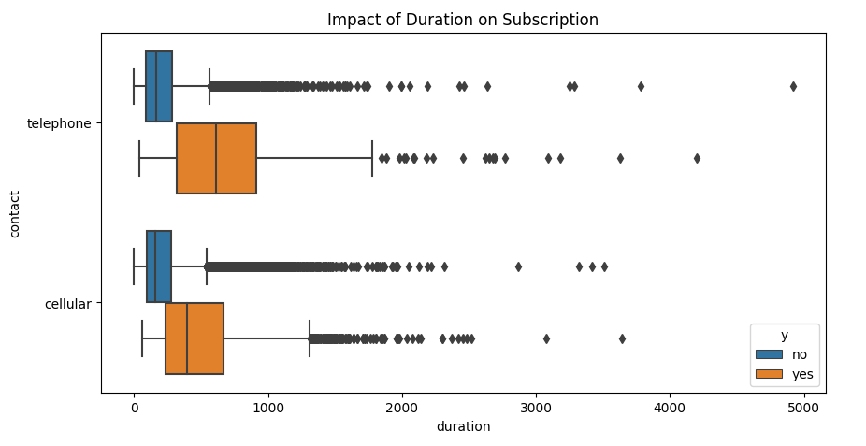
Deep Dive EDA Duration(in seconds) has the potential on Subcription
The duration of customer contacts, whether through telephone or celluler, indicates that the longer the duration, the more it impacts for prospective customer.

Slide 35
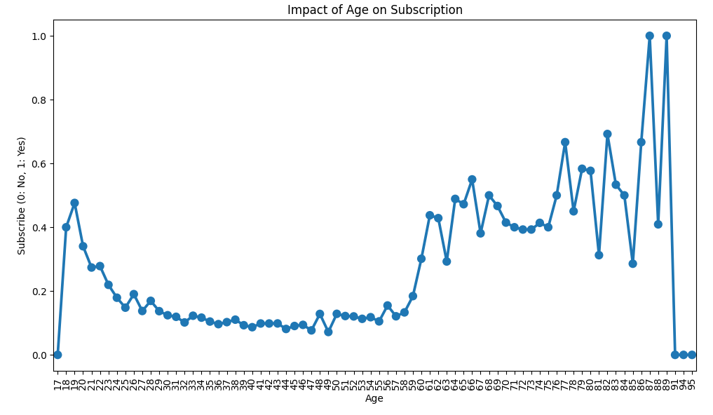
Deep Dive EDA Age on Subcription : The older, the more potential
Uptrend
Age has an impact on prospective customers when they are over 60 years old.

Slide 36
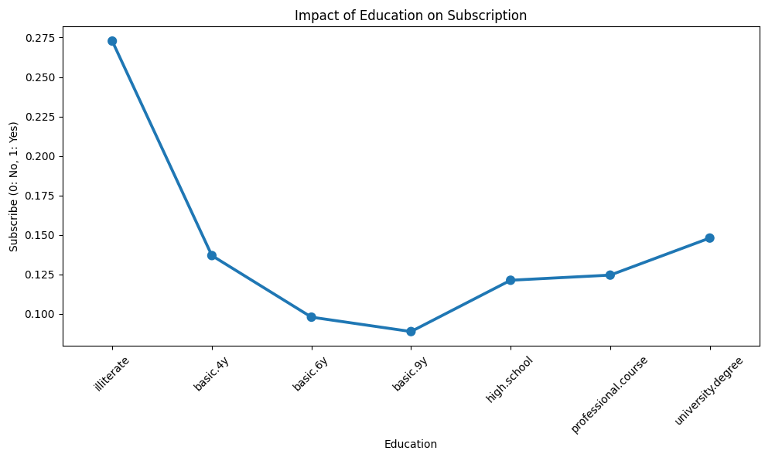
Deep Dive EDA Education on Subcription : higher education has more potential
The higher the education, the greater the impact on prospective customers.
Uptrend

Slide 37
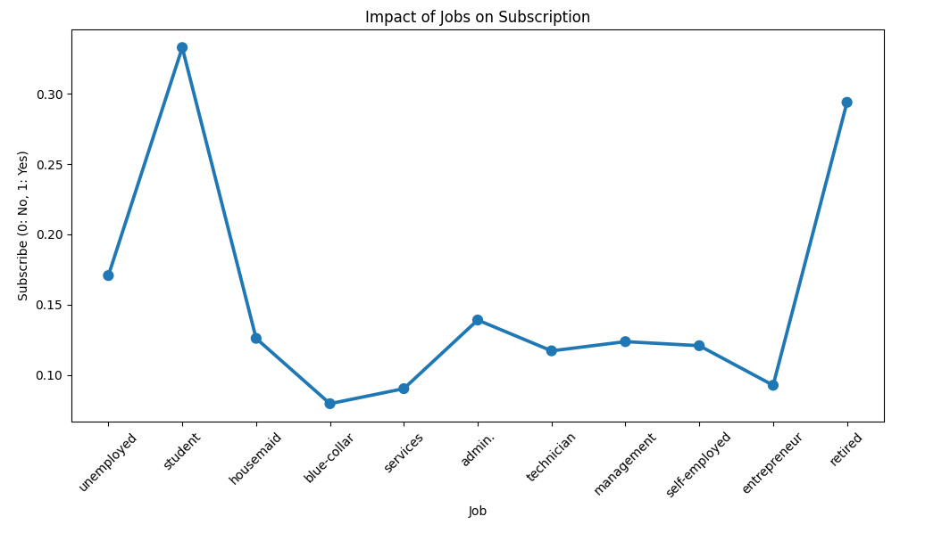
Deep Dive EDA Jobs on Subcription : Retired has the potential
Retirees have an impact on becoming prospective customers.

Slide 38
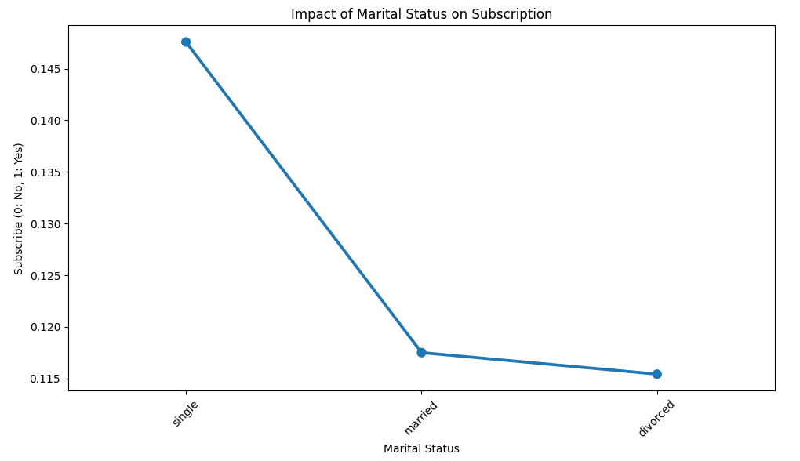
Deep Dive EDA Marital Status on Subcription : Single has the potential
Single customers have the potential to become prospective customers.

Slide 39
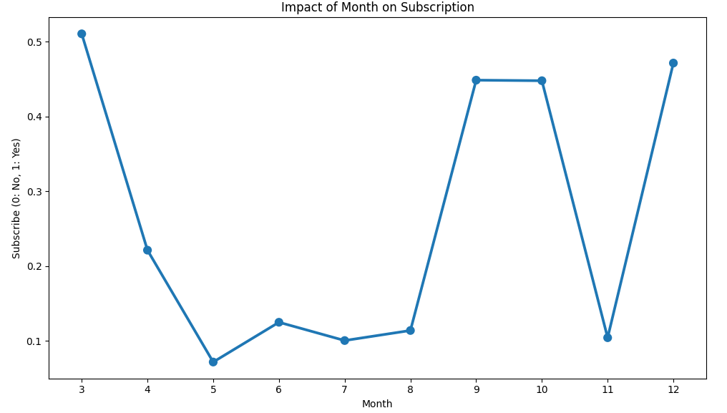
Deep Dive EDA Month on Subcription : in mar, sept, oct, & dec
The peak potential of becoming prospective customers occurs in March. Additionally, one can consider the months of September, October, and December.

Slide 40
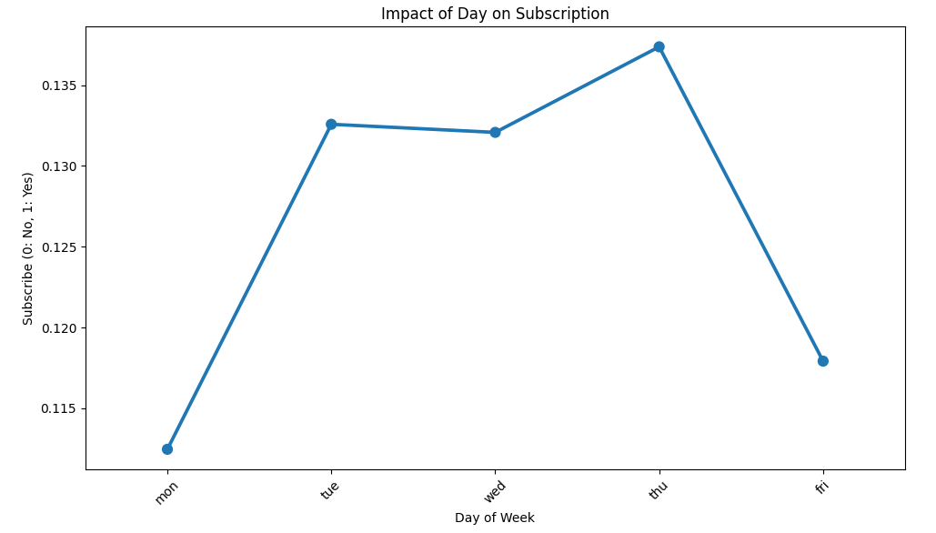
Deep Dive EDA Day of week on Subcription
On Tuesday to Thursday, there's a potential to become prospective customers.

Slide 41
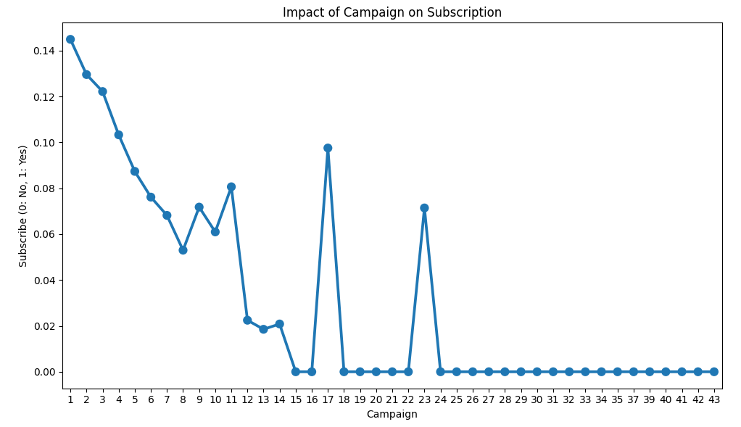
Deep Dive EDA Campaign on Subcription : high potential in low frequent
The more frequent the campaigns are conducted, the smaller the potential to become customers.
Downtrend

Slide 42
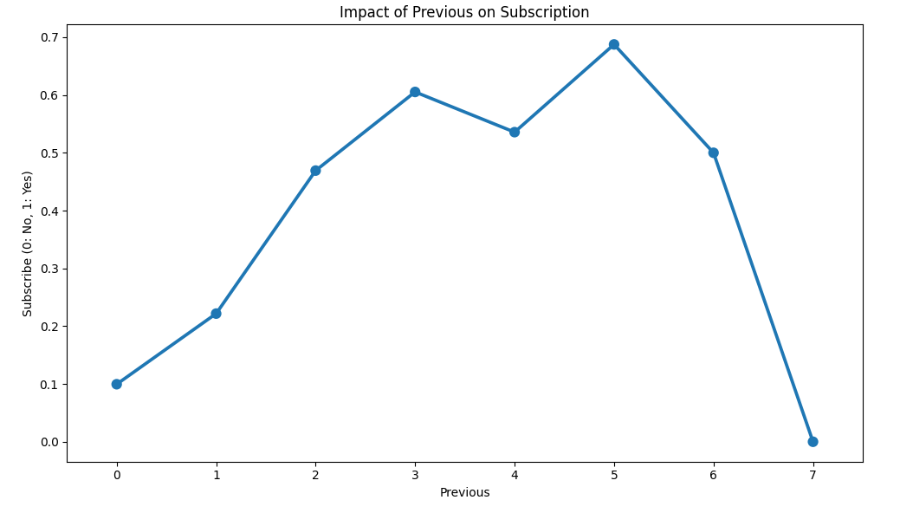
Deep Dive EDA Previous on Subcription : 0 – 5 has good potential
Having 0 to 5 contact before campaigns is a good potential for acquiring prospective customers.
Uptrend

Slide 43
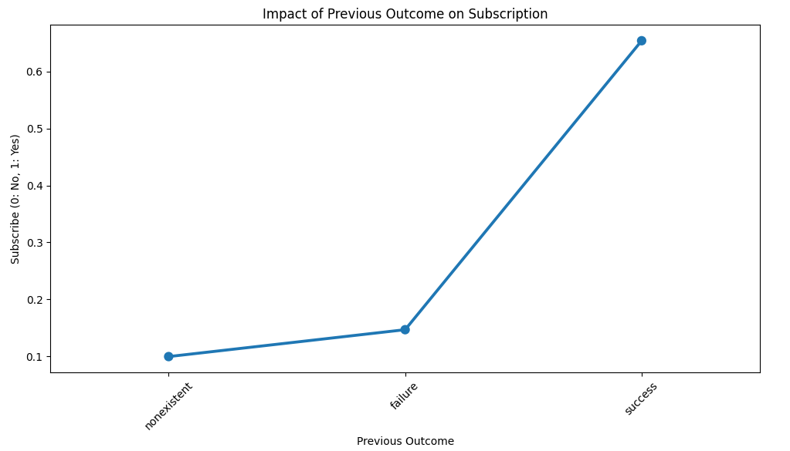
Deep Dive EDA Previous outcome on Subcription : if it worked, then it will work
If the previous campaign was successful, then there is a potential for success in the next campaign as well.

Slide 44
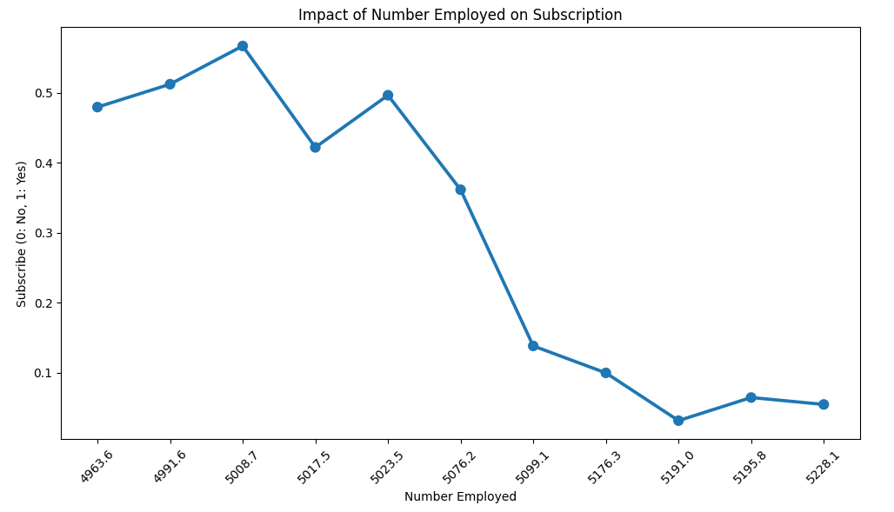
Deep Dive EDA No. employed on Subcription : high potential in small number
The larger the number of employees, the smaller the potential to become customers.
Downtrend

Slide 45
04
Recommendation

Slide 46
Recommendation
Celluler
Duration
Age
Contact via mobile celluler.
Delivery of attractive campaigns.
The elderly(>=60) are the best option.
Education
Job
Marital Status
Those with higher education(>=High School) are the best option.
Those who are retired.
Those who are single.

Slide 47
Recommendation
Month
Day of Week
Campaign
The peak is in March. Besides, it could be in September, October, and December.
Contact on Tuesday to Thursday.
Optimally conducting campaigns at the beginning.
Previous
Previous Outcome
No Employed
Can contact up to 5 times before the campaign.
Those who were successful in the previous marketing campaign.
A small number is the best option.

Slide 48

What’s the Impact?
Without machine learning and with machine learning.

Slide 49
Example
100.000
€200
Peoples
Cost/People
€50.000
5%
Deposit/People
Interest

Slide 50
Campaign Without Machine Learning
100.000
RANDOM
Peoples
12,6%
Revenue | = 100.000 * 12,6% * €50.000 * 5% | = €31.500.000
Cost | = 100.000 * €200 | = €20.000.000
Profit |  | = €11.500.000

Slide 51
Campaign With Machine Learning
100.000
POTENTIAL
Peoples
93%
Revenue | = 100.000 * 93% * €50.000 * 5% | = €232.500.000
Cost | = 100.000 * €200 | = €20.000.000
Profit |  | = €212.500.000

Slide 52
Benefit
93%
18.48X
17.48X
Cost Effiency
Increase of Profit
Attracting prospective customers.

Slide 53



Thanks!
Do you have any questions?
dimasbaswara81@.com
Please keep this slide for attribution

